Slide 1
Tehomet
Wood Poles
Notes:
Intros

Slide 2
Tehomet Wood Poles
Benefits
Drawbacks
Expected product lifetime of 25 years (1 year warranty)
Invisible seals with multi-piece product
4 stain coats for protection, color, and reducing cracks
Variety of shapes and sizes
Heavy – need equipment to install
Manufactured in Finland
  Longer lead times for domestic projects
Large quantities are preferred to maximize shipping container

Slide 3
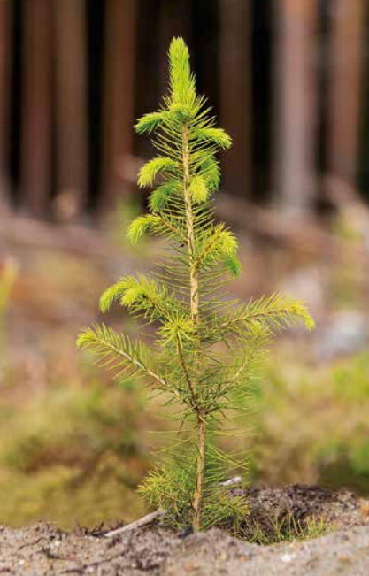

PEFC Certified Since 2009
Program for the Endorsement of Forest Certification
International forest certification program for ecologically, socially, and economically sustainable forestry
PEFC ensures the raw material originated in sustainably managed forests
About 95% of Finland’s commercial forests are certified

Slide 4
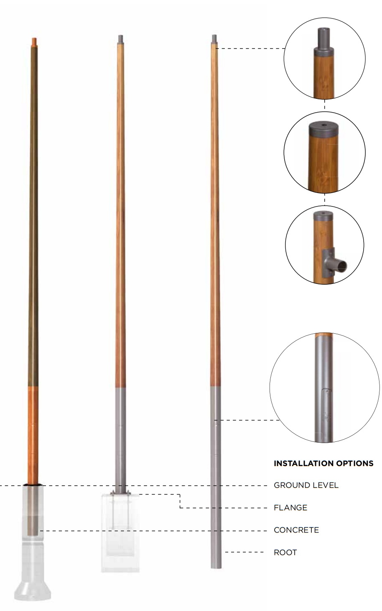
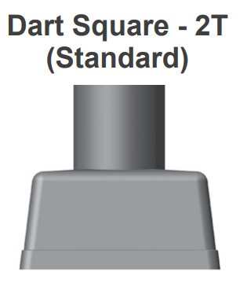
Pole Structure
The pole shaft is manufactured of high quality glued laminated timber (glulam)
The shaft is combined with a steel base
  Steel base keeps pole shaft out of standing water
  Mounts via anchor bolts
Luminaire arms, tenons, brackets, and top caps can be installed
Available Standard Heights:
  4: 13.12’
  5: 16.40’
  6: 19.69’

Slide 5
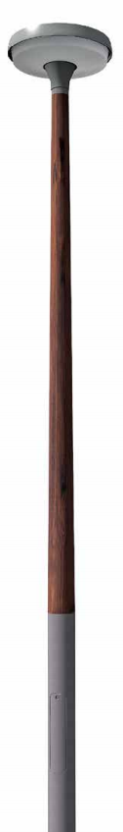
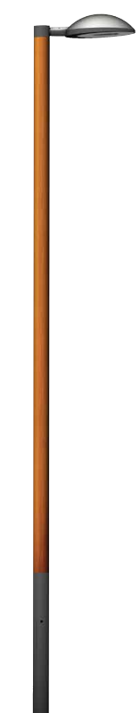
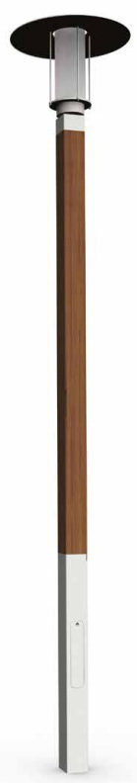
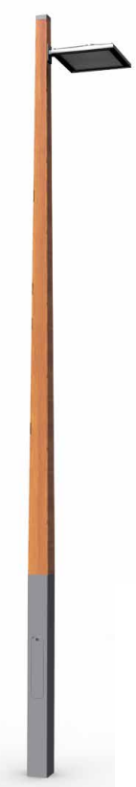
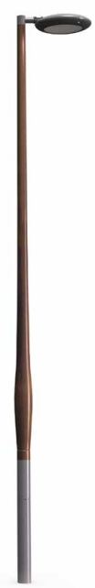
Pole Types
Pallas
Straight Round steel base
Round tapered shaft
Inari
Straight round steel base
Straight round shaft
Ruka
Straight square steel base
Straight square shaft
Koli
Straight square steel base
Square tapered shaft
Lempeä
Straight round steel base
Round tapered shaft with gentle hump

Slide 6
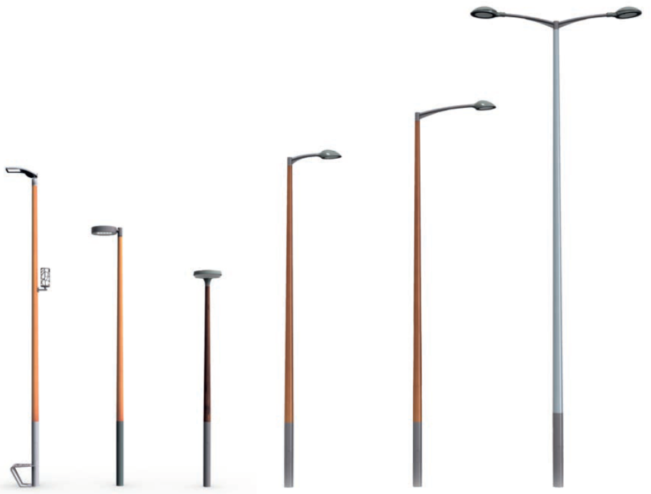
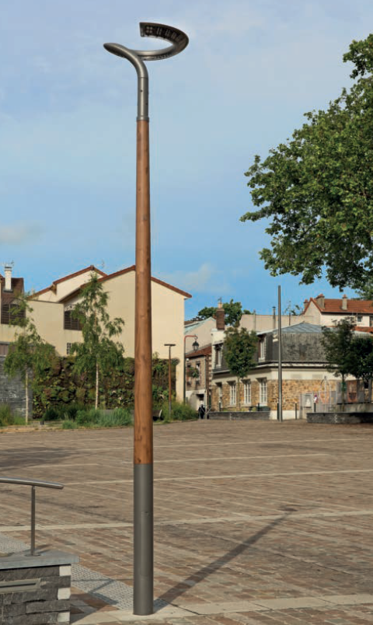
Pallas: Round Tapered

Slide 7
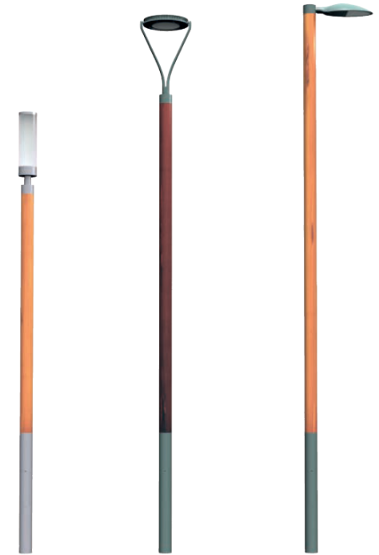
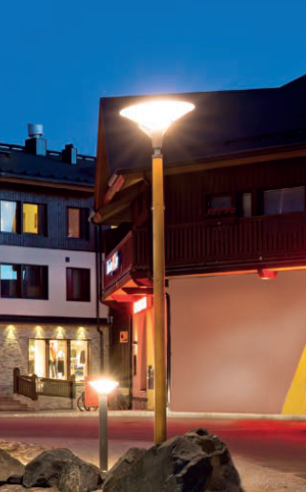
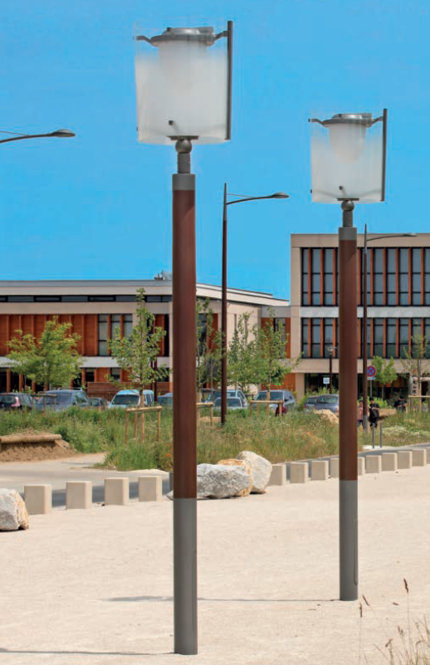
Inari: Straight Round

Slide 8
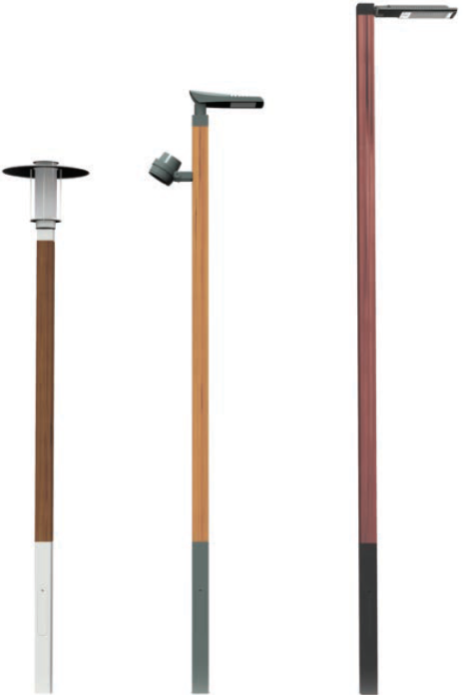
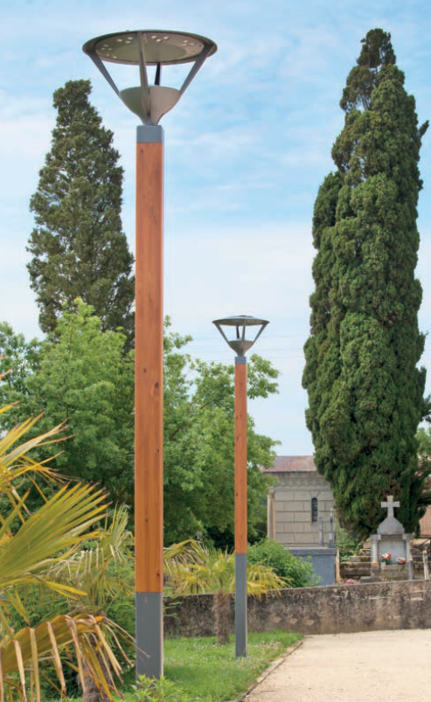
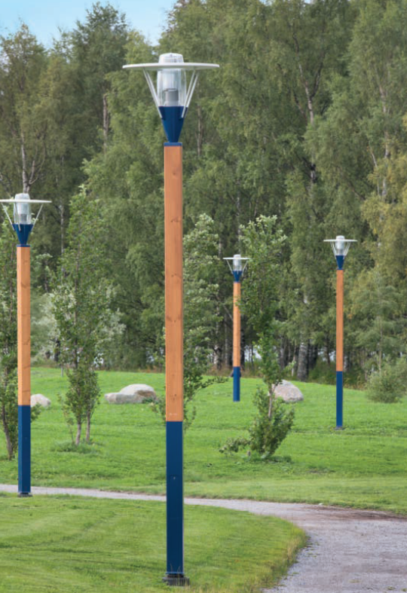
Ruka: Straight Square

Slide 9
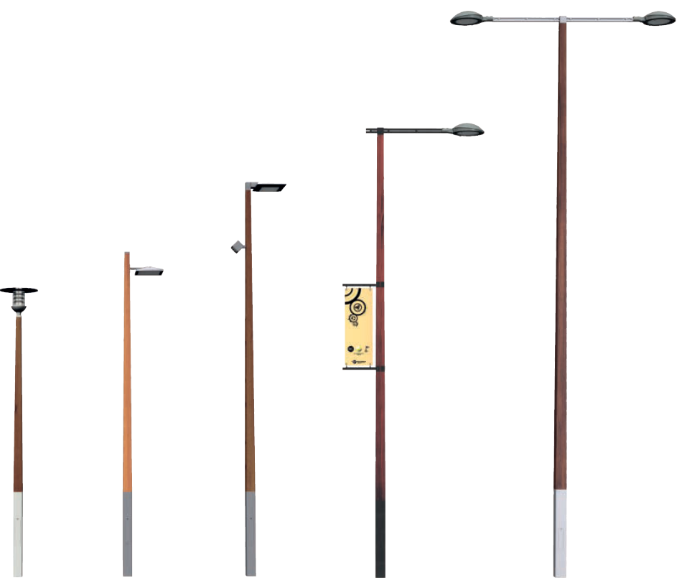
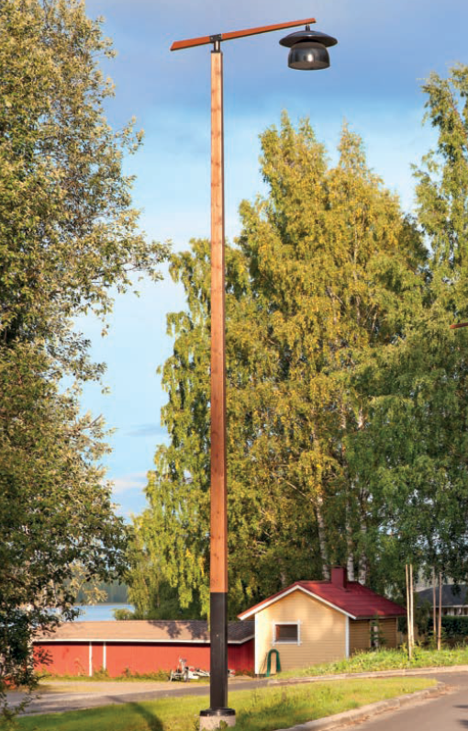
Koli: Square Tapered

Slide 10
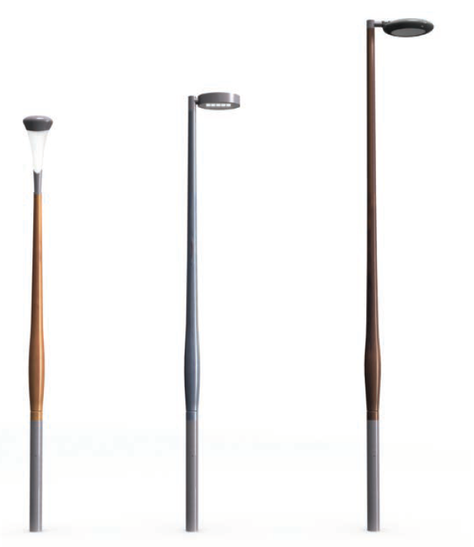
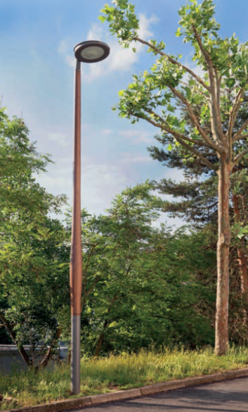
Lempeä: Round Tapered with Hump

Slide 11
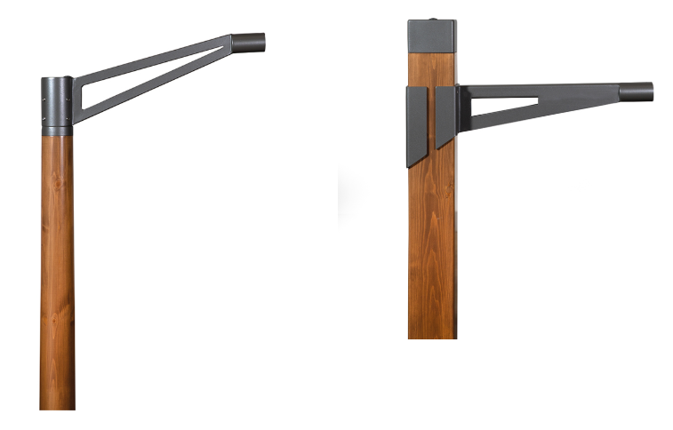
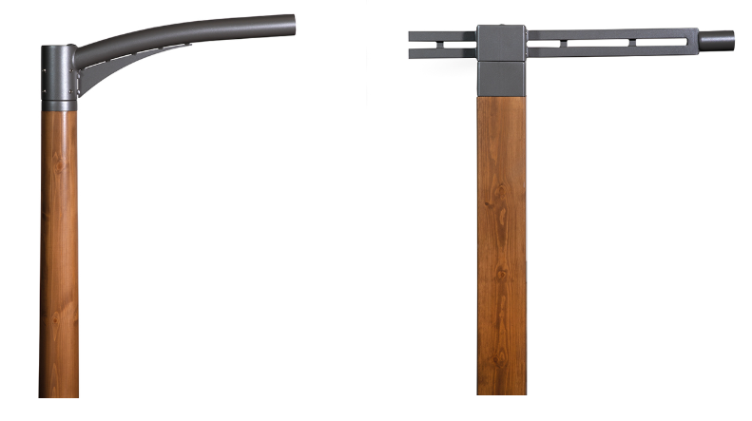
Arms
Merganser
Tikka
Gull
Swallow
Available on the following poles: Inari, Koli, Lempea, Pallas, and Ruka
Available on the following poles: Koli and Ruka

Slide 12
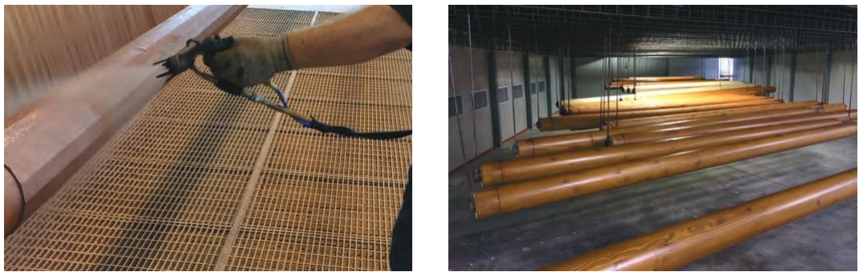
Surface Treatment
As the seasons and moisture change, the natural wood will shrink and expand.
Our elastic coating is designed to shrink and expand without cracking.
Layer 1 – preservative which protects against blue stain fungi, mildew, and rot
Layer 2 – color application
Layers 3 - 4 – multiple layers of colored tinted varnish to protect against UV
**Graffiti resistant
Spray gun application
Drying chamber

Slide 13
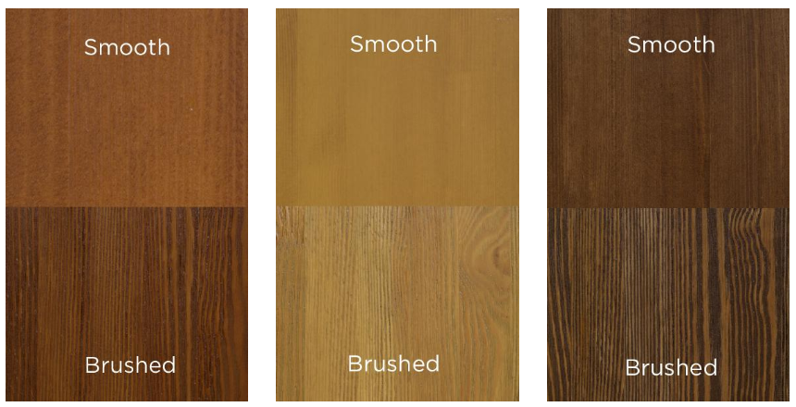
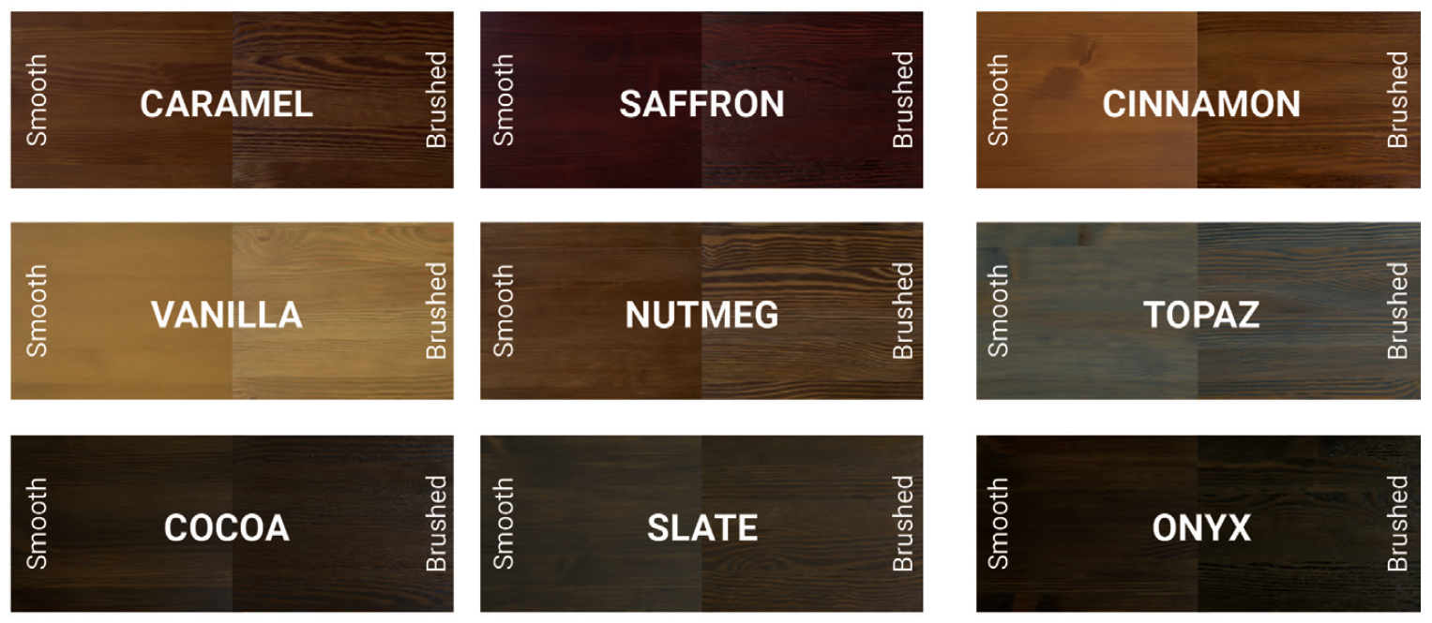
Surface Treatment

Slide 14
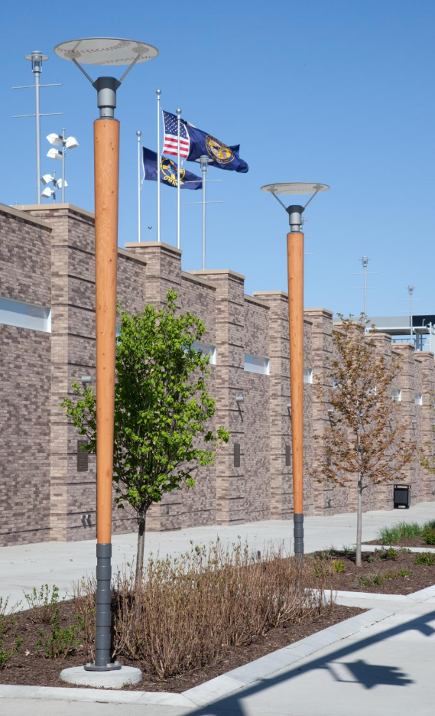
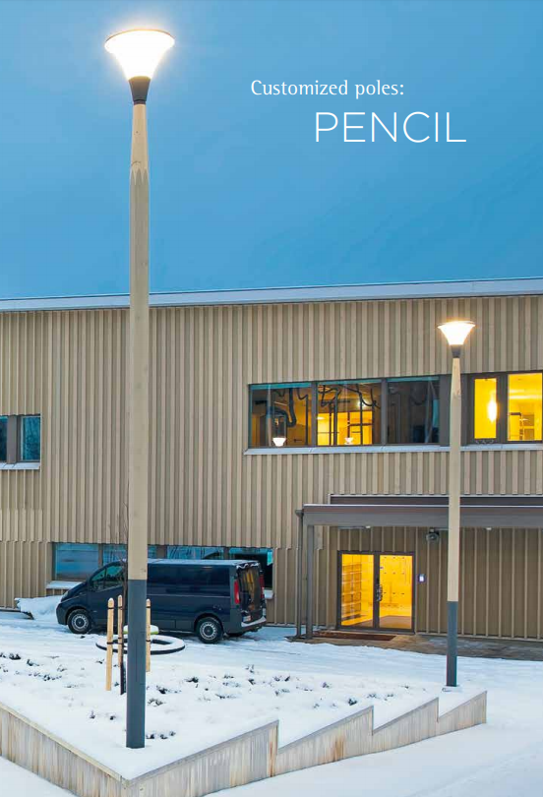
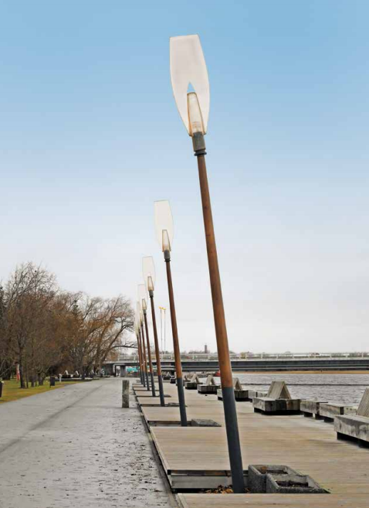
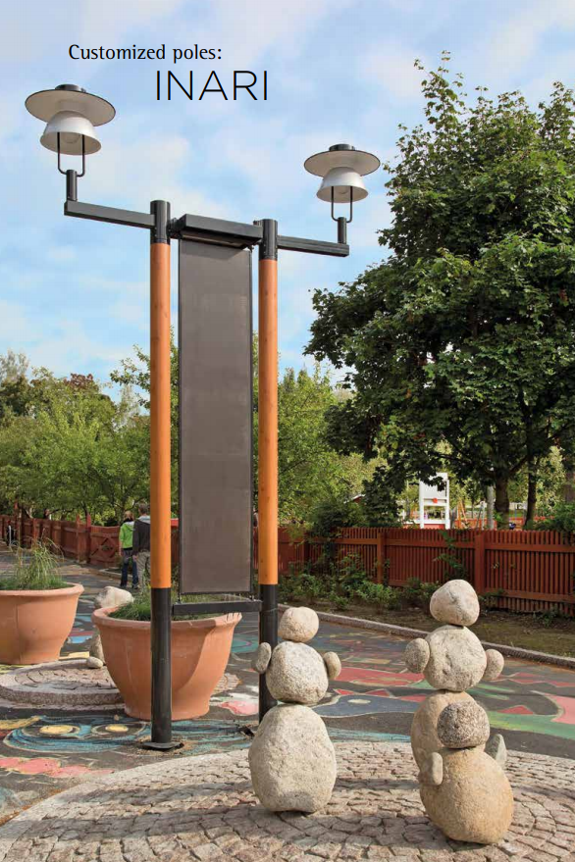
Custom Designs

Slide 15
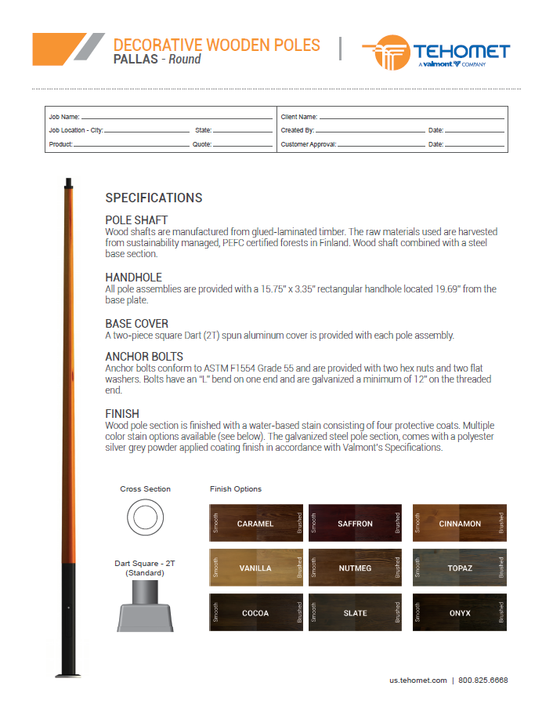
Specification Pages
Access pole specifications here:
http://us.tehomet.com/resources/product-literature

Slide 16
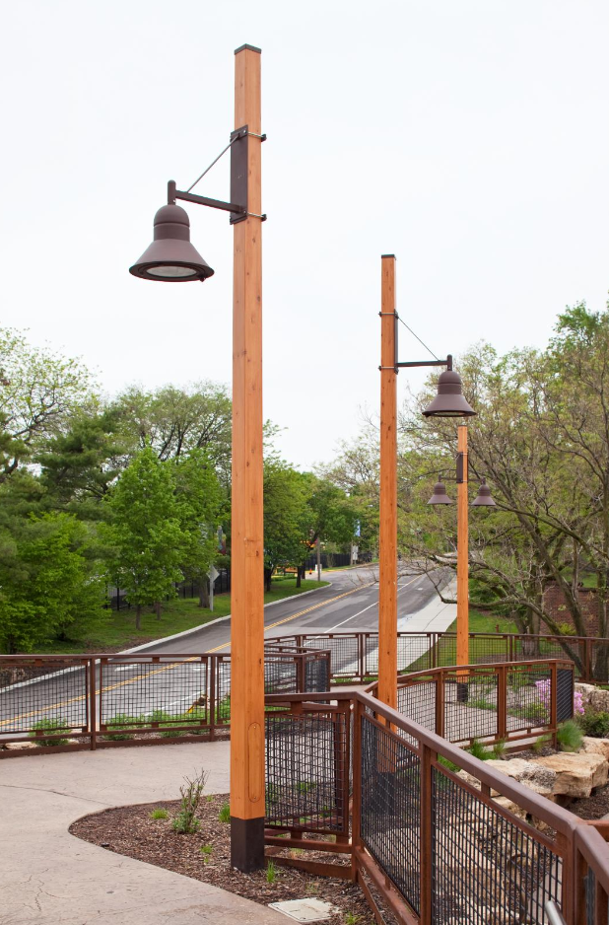
Quotes and Orders
Contact your current Valmont Steel Project Administrator for quotes and orders
Due to overseas shipment of the product, it is much more cost effective to order 10+ poles.
Lead times typically 14-16 weeks

Slide 17
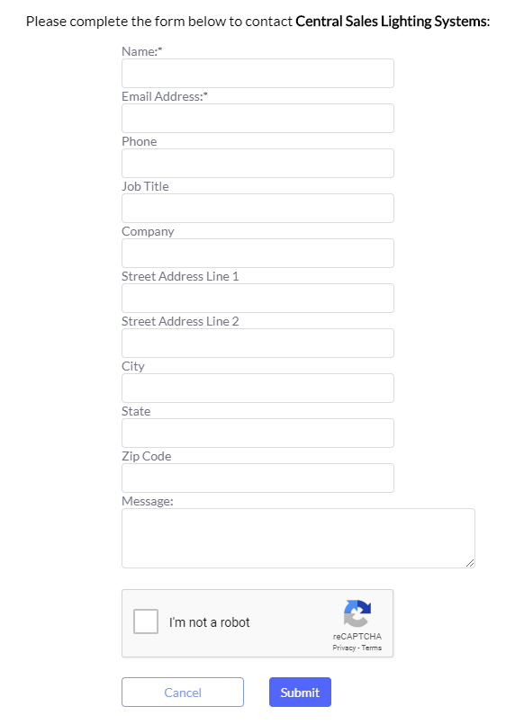
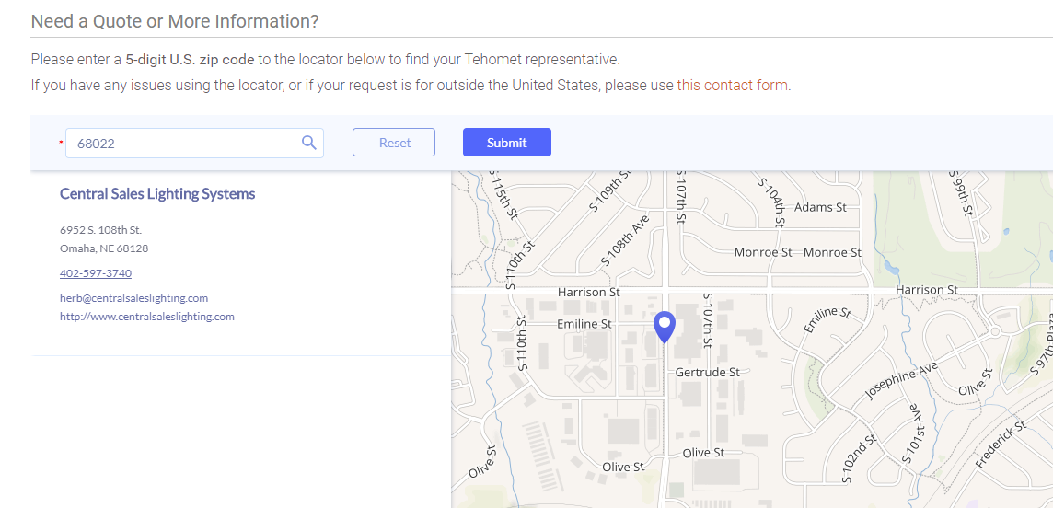
Find Your Rep
US.Tehomet.com
  About
    Find Your Rep

Slide 18
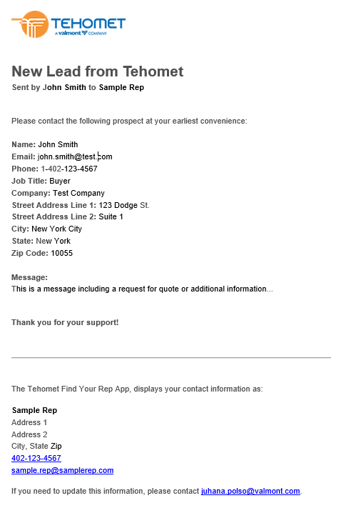
Find Your Rep
When a prospective customer chooses to contact you directly using a contact form in our new Find Your Rep app, the app will send you a notification. Here’s an example of the information you will receive:
  Prospect contact information
Please use the information to help the prospect at your earliest convenience. Any updates to your own contact information should be sent to juhana.polso@valmont.com.
  Message/Request
  Your contact information displayed on the app

Slide 19
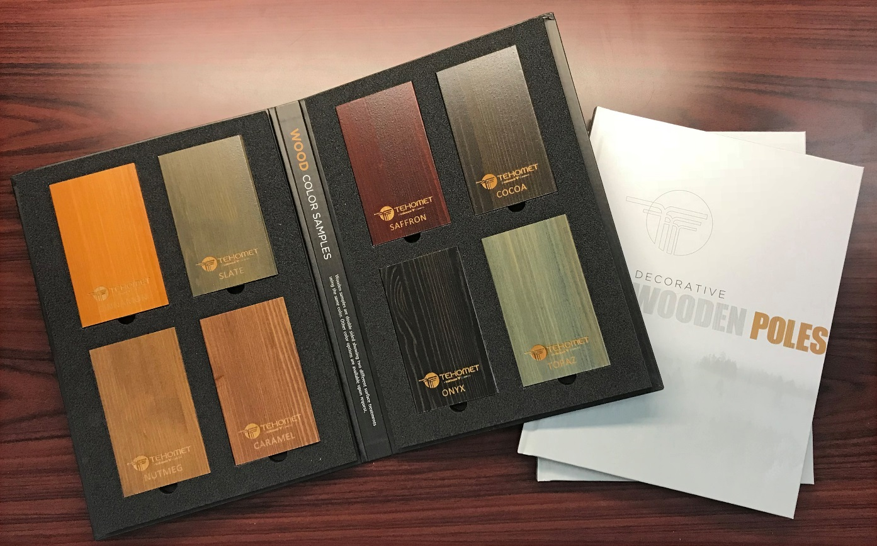

Sample Kits
What you’re getting
Hardcover product book x2
Wood sample of each color

Slide 20
THANK YOU!
www.valmontstructures.com

